Slide 1
Basic electronic component tester
Lukács Botond

Slide 2
Goals
Finding resistors, capacitors, diodes and transistors pinout and approximate values in an automated way with a help of a microcontroller.
Plotting the transistors characteristic diagramm.
Automated testing.
Ease of use.

Slide 3
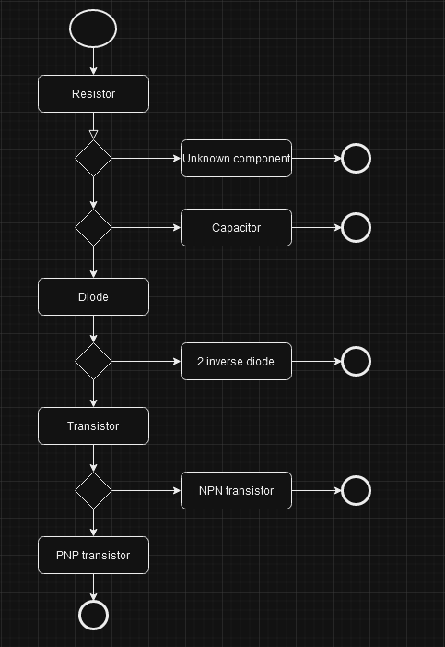
Component identification steps

Slide 4
System block diagram
USB
Serial communication and power
DAC
Microcontroller
Display
SPI
SPI
3 analog voltage signal
Start Switch
Digital control signals
Analog switch
Status LED
ADC signals
Tester socket
Selected signal

Slide 5
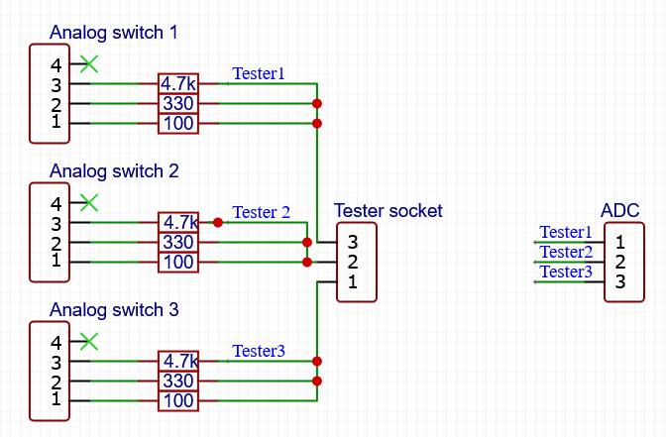
The measuring circuit

Slide 6
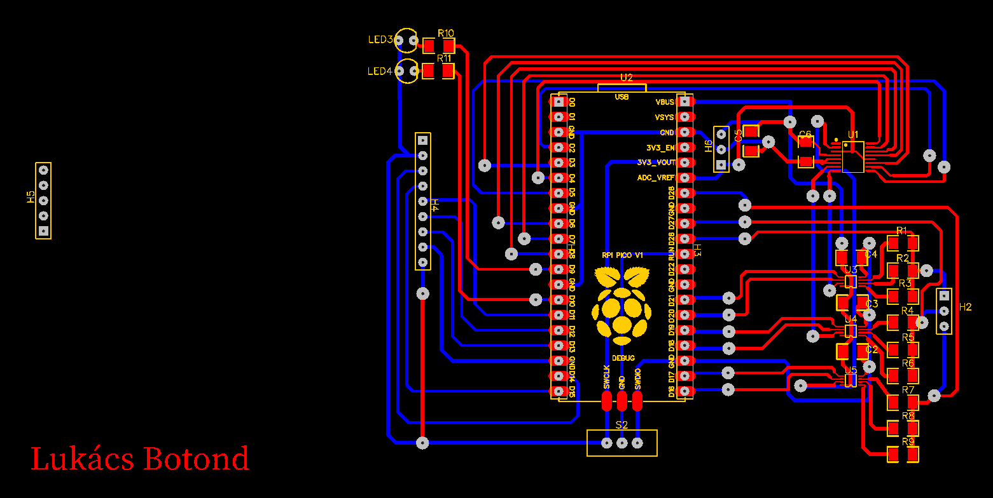
Circuit diagram

Slide 7
Current control
The DAC only controls the voltage, so software based control is required
A P controller is used for this
This is required for the transistors characteristic diagram

Slide 8
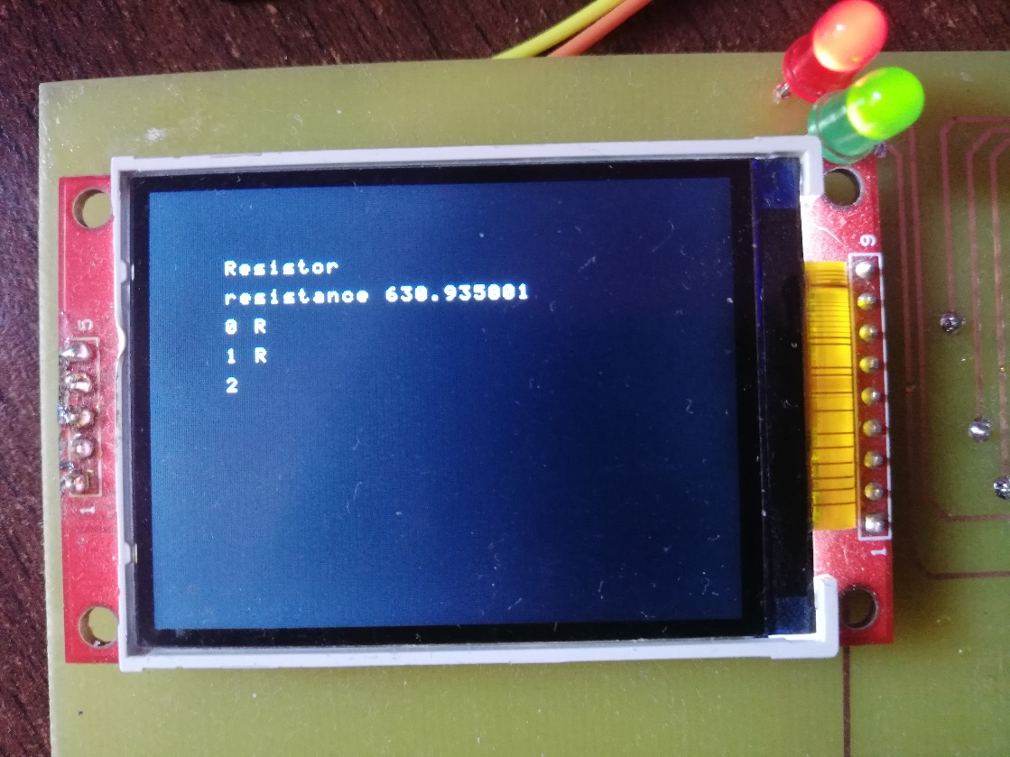
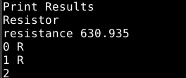
Displaying results

Slide 9
Resistor testing

Slide 10
Capacitor testing

Slide 11
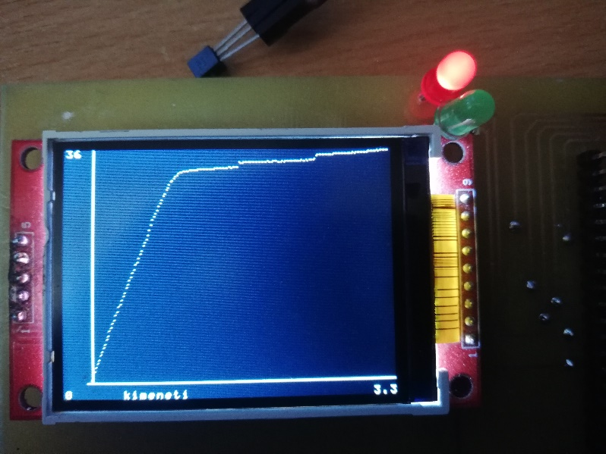
Output characteristic
Y axis is the collector current in mA. The X axis is the Collector-emitter voltage in V

Slide 12
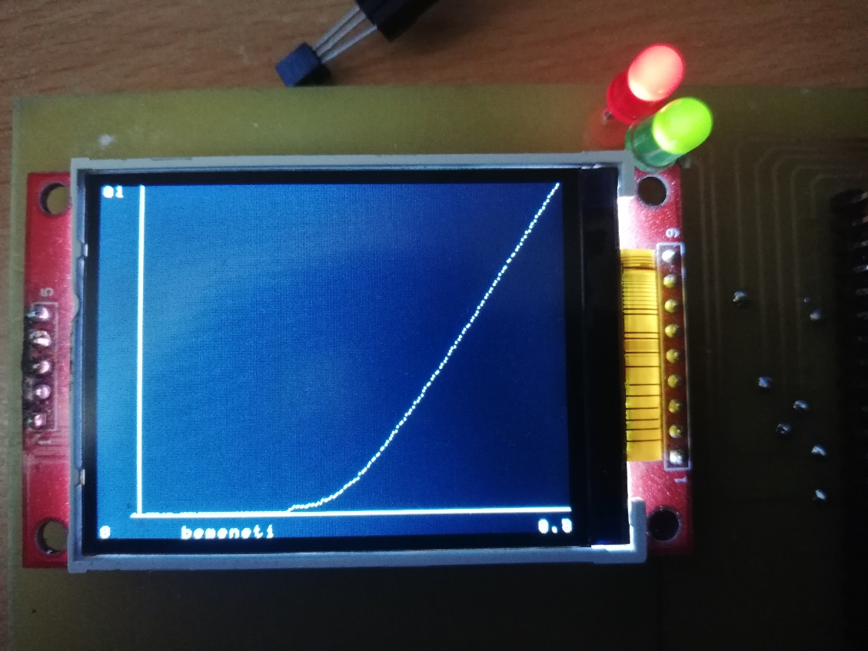
Input characteristic
In this case the collector and emitter is connected to ground. On the base increases the voltage and measures the current flowing through it.

Slide 13
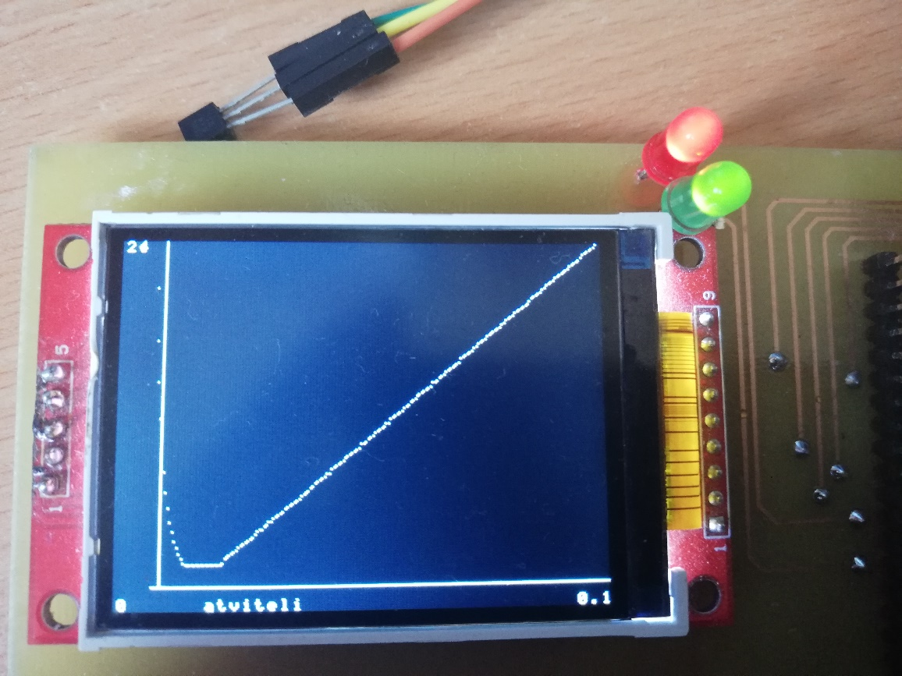
Transfer characteristics
In this case the collector-emitter voltage is constant and increases the base current. If this current is high enough then the transistor turns into a switch.

Slide 14
Realizations
The tester can identify resistors, capacitors, diodes and transistors with approximate accuracy, while also identifies the pinout.
Displays the results on it’s built in display and only requires a USB power supply.
Simple usage and automated testing

